Slide 1
COVID-19: ANALYSIS AND VISUALIZATION
Bunmi Olakanmi
Chris Inalsingh
Moné-Renata Holder Seale
Nihal Joshua

Slide 2
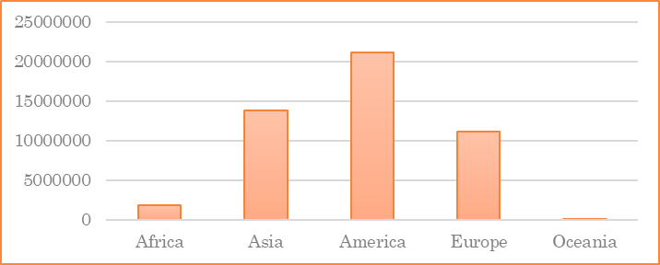
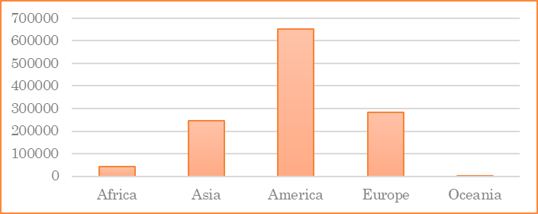
MOTIVATION & SUMMARY
COVID-19, a disease caused by SARS-CoV-2 corona virus.
First recognized in December 2019.
Declared a pandemic by WHO in March 2020
Cases and deaths reported till Nov 5, 2020:
COVID - 19 Cases
Deaths due to COVID - 19

Slide 3
MOTIVATION & SUMMARY
Interventions:
  Limit to the size of indoor and outdoor gatherings
  Physical distancing of 2ft from the next person
  Use of mask
  Increased testing
Impacts
  Employment
  GDP
  Lifestyle change
  Increased mortality
Notes:
https://www.ecdc.europa.eu/en/geographical-distribution-2019-ncov-cases

Slide 4
MOTIVATION & SUMMARY
With the rise in the number of cases and mortality in some regions, we want to:
  Know what the trend is like in Canada.
  Know the economic impacts of COVID-19
    Unemployment and GDP growth.
  Know the impacts of COVID-19 on excess deaths
  Know the relationship between COVID-19 deaths and deaths due to Influenza / Pneumonia.
Notes:
https://www.ecdc.europa.eu/en/geographical-distribution-2019-ncov-cases

Slide 5
QUESTIONS
What is the wave of COVID-19 in Canada?
  From February 2020 to September 2020.
What is the impact of COVID-19 on unemployment in Canada?
What is the impact of COVID-19 infections on excess deaths?
Is there a trend between COVID-19 related deaths, and deaths due to seasonal flu (pneumonia and influenza)?
What are the key patterns observed between interventions and economic impact?
  COVID-19 vs. GDP growth for different countries
Notes:
Americas (North America, South America, Central America, Caribbean),
Asia Pacific (Central & South Asia, Northeastern Asia, Southeastern Asia, Australia and Oceania),
Europe (Northern Europe, Southern Europe, Eastern Europe, Western Europe),
and the Middle East/Africa (Middle East, Northern Africa, Southern Africa)

Slide 6
METHODS: DATA
Our data comprise COVID-19 data on unemployment, GDP growth, mortality count from sources, such as:
  Centers for disease control and prevention – CDC.gov¹
  Kaggle²
  The centre for humanitarian data³
  Ourworldindata⁴
  COVID19 Canada⁵
1. https://data.cdc.gov/NCHS/Provisional-Death-Counts-for-Influenza-Pneumonia-a/ynw2-4viq/data
2. https://www.kaggle.com/sudalairajkumar/novel-corona-virus-2019-dataset
3. https://data.humdata.org/dataset/financial-times-excess-mortality-during-covid-19-pandemic-data
4. https://ourworldindata.org/covid-health-economy
5. https://resources-covid19canada.hub.arcgis.com/datasets/0ecd269194284477b883465e99354ba3_0/geoservice
Notes:
To answer these questions, we analysed data from different source, as mentioned above:

Slide 7
METHODS: DATA CLEANUP & EXPLORATION
Data download from resource websites
Data import to Jupiter notebook
Data cleaning: using python libraries to exclude irrelevant and incomplete data
Data analysis and visualization to answer our questions
  Summary statistics
  Regression analysis
  Scatter plots
  Bar chats

Slide 8
METHODS: DATA ANALYSIS
Q1: Time series of confirmed COVID-19 cases in Canada.
Q2: Regression between confirmed cases per month and unemployment rate in Canada (Mar – Sept 2020).
Q3: Regression on excess mortality rate and COVID-19 infected
Q4: Regression between deaths due to COVID-19 and seasonal flu (Pneumonia/Influenza) in the USA.
Q5: Bar graph comparing GDP growth for some countries.
  (GDP Growth-Q2, 2020)
Notes:
What are the waves of COVID-19 across the regions of the world?
Africa, Asia, America, Europe, Oceania.
What are the successes recorded with the COVID-19 Interventions in these regions?
What is the Economic Impact of COVID-19?
Unemployment, stock market, inflation
COVID-19 and impact on other mortality rates due to lifestyle
e.g. driving, drinking, drugs
Differences between COVID-19 Infections and normal Flu.
Key patterns observed between interventions and flattening the curve.
Key patterns observed between interventions and long-term economic impact.

Slide 9
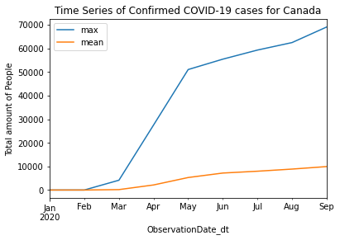
RESULTS & DISCUSSION (Q1)
Initial slight increase in cases (Feb – Mar), which became steeped in spring (Mar – May).
Then, the curve was getting flattened in the summer months (May – Aug)
An increase in cases is observed from September.
Notes:
Average increase in cases was higher in the spring than the summer months
The curve seemed flattened during the summer months
An increase is observed from September

Slide 10
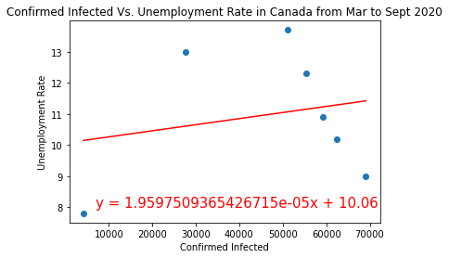
RESULTS & DISCUSSION (Q2)
R = 0.21, p = 0.65
There is a weak positive relationship between confirmed COVID-19 cases and unemployment rate in Canada.
  As the number of cases increases, we expect just a very small increase in the unemployment rate.
  Reasons: CERB, wage subsidies
Notes:
This is expected because the Canadian government did a lot to reduce the impact of COVID on employment – CERB, wage subsidy (75%) to employers, loans to entrepreneurs (40k)

Slide 11
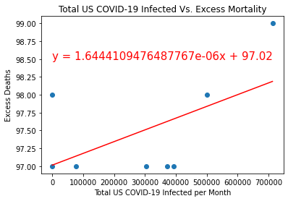
RESULTS & DISCUSSION (Q3)
r = 0.55, p = .15
There is a moderate positive relationship between COVID-19 infected and deaths due to other issues.
  We expect an increase in excess death with an increase in COVID-19 infections.
  Reason(s): rise in mental health conditions, delayed in medical interventions for people with comorbidities, inadequate medical facilities.

Slide 12
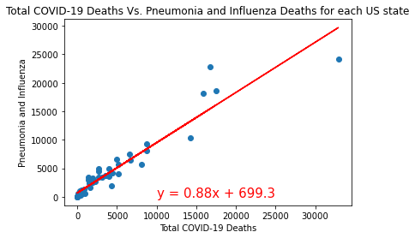
RESULTS & DISCUSSION (Q4)
r= 0.95, p = 1.84e-27
There is a strong positive relationship between the total COVID-19 deaths, and deaths due to seasonal flu (pneumonia and influenza) in the USA.
  COVID-19 related death is very similar to death due to seasonal flu in the USA.
  Reasons(s): mode of transmission and symptoms.
  Further work is required to uncover other contributory factors

Slide 13
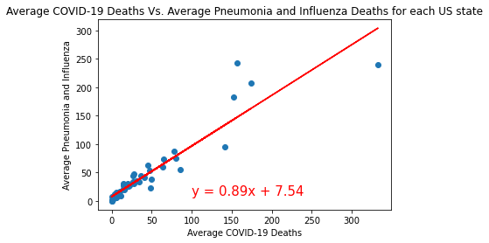
RESULTS & DISCUSSION(Q4)
r= 0.93, p = 1.71e-23
There is a strong positive relationship between the average COVID-19 deaths, and average deaths due to seasonal flu (pneumonia and influenza) in the USA.
  Average COVID-19 related death is similar to average death due to seasonal flu in the USA.

Slide 14
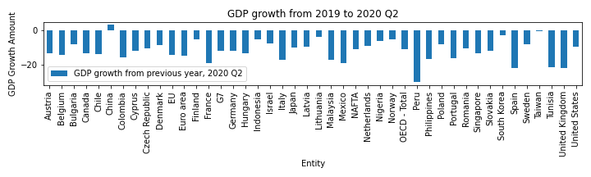
RESULTS & DISCUSSION (Q5)
With respect to GDP growth, most countries, except China, are negatively impacted in Q2 of 2020.
Most negative impacts felt in some of the following regions
  South America: Peru, Mexico, Colombia
  Europe: United Kingdom, Spain, France, Italy
  Africa: Tunisia

Slide 15
SUMMARY
There is a surge in COVID-19 cases in Canada from September.
COVID-19 has a small effect on unemployment in Canada, from March-September 2020.
  An increase in excess death is expected with an increase in COVID-19 infections.
There is a strong positive relationship between COVID-19 related deaths, and deaths due to pneumonia and Influenza in the USA.
  We should expect a further increase in death due to pneumonia and influenza, when there is an increase in COVID-19 related deaths.
There is a negative trend in the GDP growth of most countries, except China, in the Q2 of 2020.

Slide 16
LIMITATIONS
Lack of economic data to project the effects of COVID-19.
  Most countries stopped the long term economic projection due to COVID-19 effect.
Bias in data due to differences in testing rates and interventions between countries.
Inability to validate statistics coming from different countries.

Slide 17
QUESTIONS

